Slide 1
ENHANCING ENDPOINT SECURITY THROUGH AI POWERED ANOMALY DETECTION IN ENDPOINT LOGS USING LOCAL OUTLIER FACTOR (LOF)
TEAM MEMBERS
P. Krishna Sai -9921004578
Y. Subhan Basha-9921004795
Shaik Sohel-9921004817
Y. Venkateshwara Reddy-9921004789

Slide 2
PROBLEM STATEMENT
In today’s digital era cybersecurity landscape, endpoint security remains a critical concern due to the increasing sophistication of cyber threats. This study explores anomaly detection using AI-powered techniques to enhance endpoint security by identifying malicious login attempts. We utilize the BETH dataset, publicly available, which contains authentication logs and security event data, enabling a comprehensive analysis of user behavior and potential threats. We utilize Three machine learning classifiers that is One-Class SVM, Isolation Forest, and Local Outlier Factor (LOF) were employed for anomaly detection.
Additionally, outlier detection techniques, such as box plots, were applied to visualize and analyze data anomalies. The results indicate that density-based anomaly detection methods outperform traditional approaches in identifying security threats. This research proposed the efficiency of AI-based anomaly detection in cybersecurity and underscores the potential of machine learning for real-time Anomaly detection.

Slide 3
EXISTING SYSTEM
Traditional anomaly detection approaches in endpoint security primarily rely on rule-based, signature-based, and heuristic methods to identify threats. These conventional techniques have been widely used for detecting known attack patterns, unauthorized access, and suspicious activities in system logs. However, they often fail to detect novel, evolving, and zero-day threats due to their reliance on predefined rules and past attack signatures.
1. Signature-Based Detection
  Signature-based detection methods identify threats by comparing system activity against a database of known attack signatures. This approach is widely used in antivirus software, intrusion detection systems (IDS), and firewalls.
  While effective against previously identified threats, signature-based detection is limited in detecting new or unknown attacks, as it requires frequent updates to its signature database.
2. Rule-Based and Heuristic Approaches
  Rule-based anomaly detection systems define a set of pre-configured rules that specify normal and abnormal behaviors. Security administrators manually establish these rules based on historical attack patterns. Heuristic-based approaches improve upon rule-based methods by using if-then conditions and behavioral analysis to flag suspicious activity.
  However, these methods generate high false positives and require constant manual tuning to adapt to new threats

Slide 4
Existing system
3. Statistical Anomaly Detection
  Statistical models analyze historical data to establish a baseline of normal user behavior and identify deviations as potential anomalies. Common statistical techniques include:
  Mean and standard deviation analysis – Flags any activity deviating significantly from the mean as an anomaly.
  Probability-based anomaly detection – Uses probability distributions to determine whether an event is abnormal.
  While statistical models can detect anomalies without relying on attack signatures, they struggle with dynamic environments where user behavior frequently changes, leading to false alarms.

Slide 5
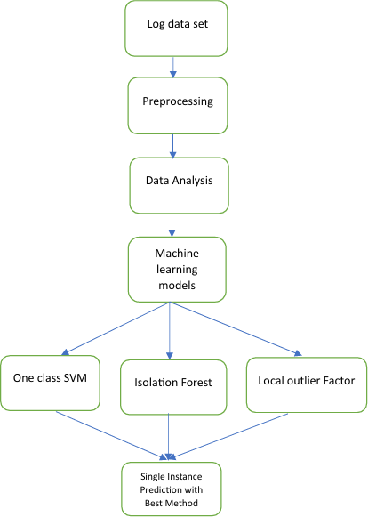
Detailed information about proposed Methodology
Work flow for proposed methodology

Slide 6

Detailed information about proposed Methodology
Log data collection
  The proposed system is evaluated using the BETH dataset, a real-world dataset designed for malicious login detection in cybersecurity.
  It contains a comprehensive collection of authentication logs and security event logs, making it highly suitable for analyzing user behavior and detecting malicious activities.
Preprocessing
  In this preprocessing ,we using BETH dataset for Correcting errors, removing redundancies, and handling missing data.
  Data preprocessing involves techniques such as cleaning the data to handle missing values, removing outliers, scaling features, encoding categorical variables, and splitting the data into training and testing sets.

Slide 7
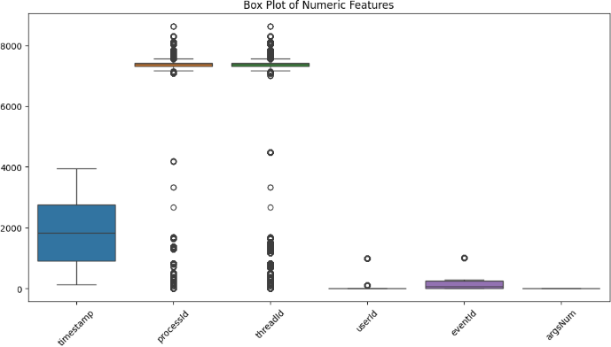
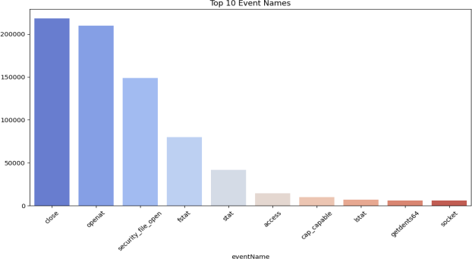
Detailed information about proposed Methodology
Data analysis
  It is important to investigate and understand the data better before building a model with it.
  Thorough analysis of the data ,the visualization is valuable for understanding data distribution and detecting anomalies that could affect data analysis or modelling .

Slide 8
Detailed information about proposed Methodology
Machine Learning techniques
One class svm
  Boundary-Based Approach – Constructs a decision boundary (hypersphere) around normal data to separate anomalies Kernel Trick for Flexibility
  Uses kernel functions (e.g., RBF) to map data into a higher-dimensional space for better separation Hyperparameter Sensitivity
  Performance depends on kernel choice and parameters, requiring careful tuning for accuracy.
Isolation Forest
  Tree-Based Partitioning – Isolates anomalies through recursive random splits, requiring fewer splits for outliers than normal points.
  Efficiency and Scalability – Works well on large, high-dimensional datasets with low computational cost
  Hyperparameter Importance – Performance depends on the number of trees and sample size, requiring optimization for best results.
Local Outlier Factor (LOF)
  Density-Based Anomaly Detection – Detects anomalies by comparing the local density of a point to its k-nearest neighbors.
  Local Sensitivity – Effective in identifying anomalies in varying density regions, unlike global methods.
  Computational Complexity – Can be expensive for large datasets and is sensitive to the choice of k (number of neighbors).

Slide 9
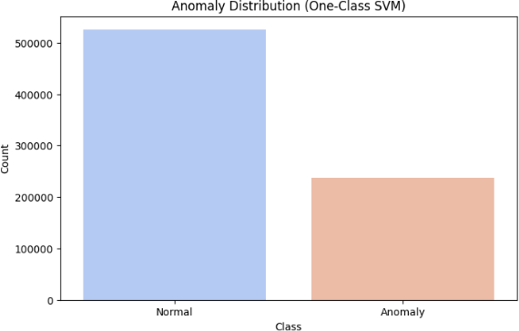
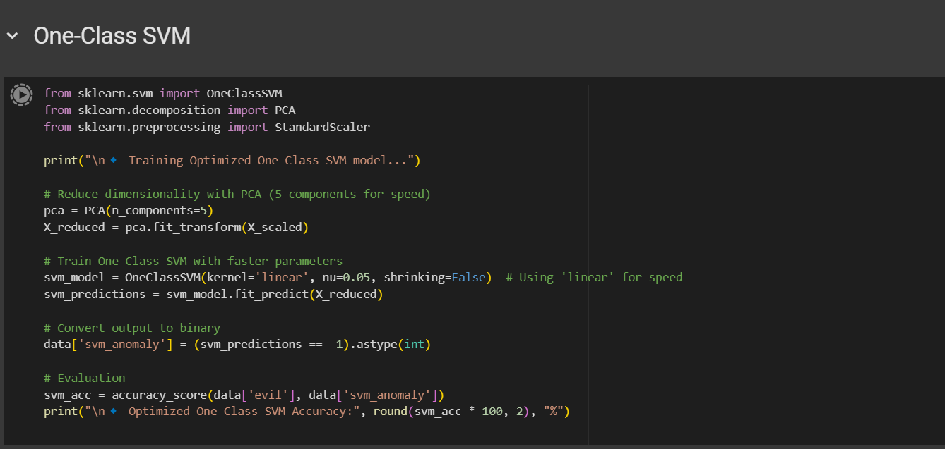
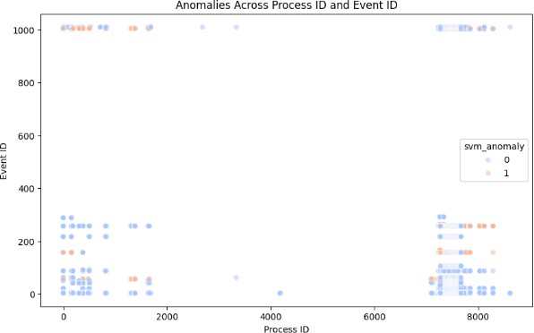
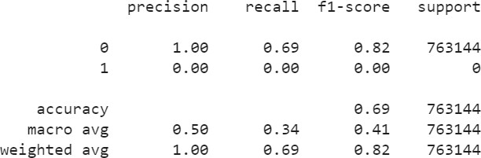
Implementation
ONE CLASS SVM
One class SVM

Slide 10
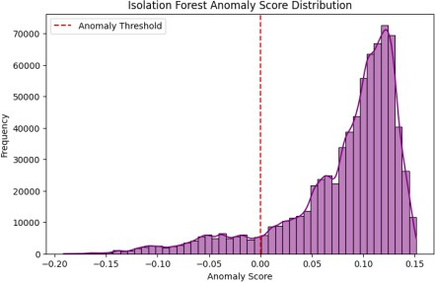
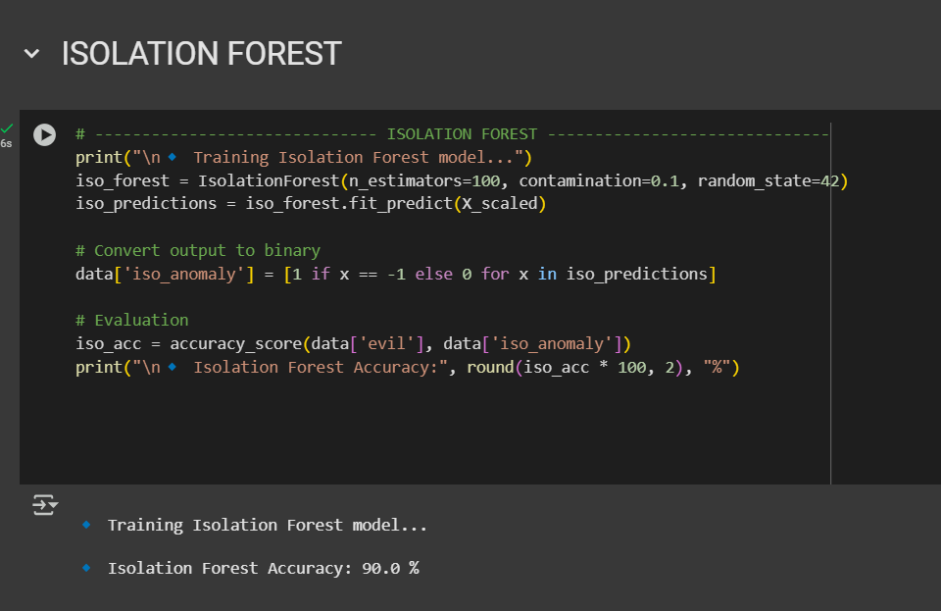
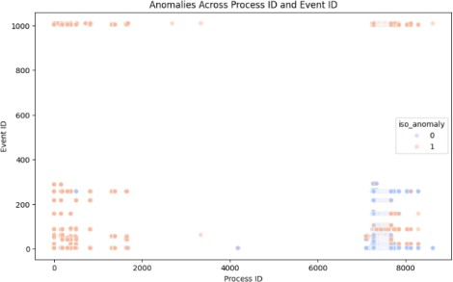
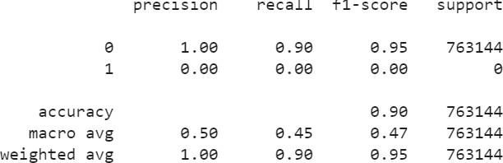
Implementation
ISOLATION FOREST

Slide 11
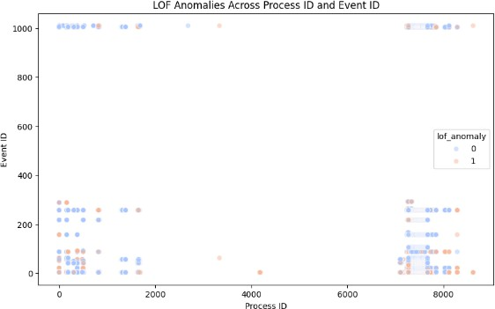
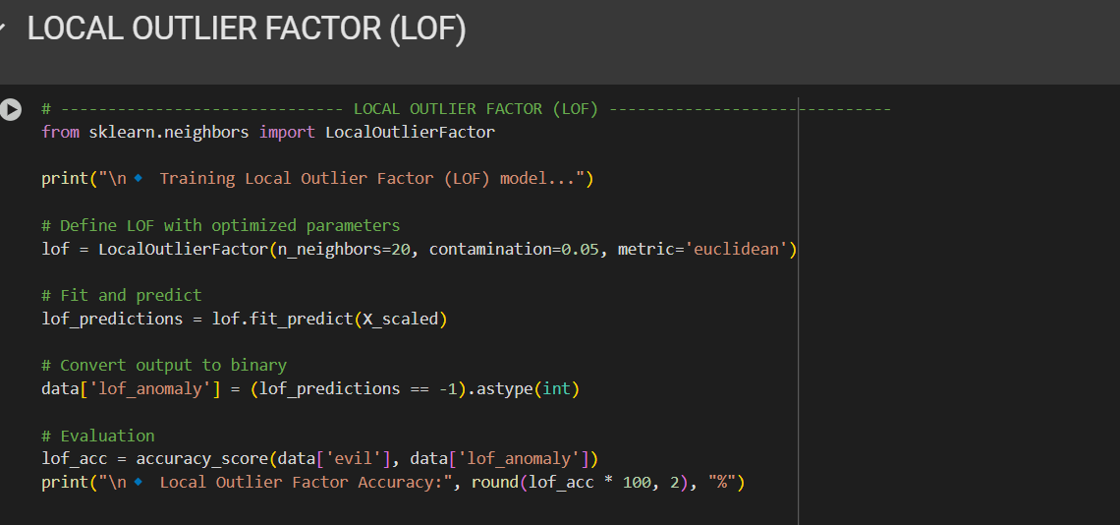

Implementation
LOCAL OUTLIER FACTOR (LOF)

Slide 12
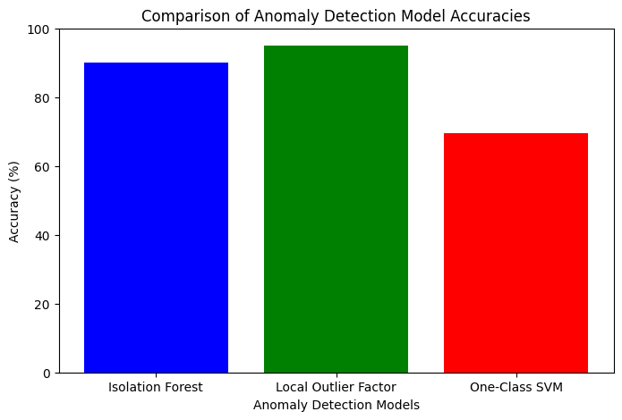
Implementaion
accuracy of the all methods in graph format

Slide 13
COMPARSION TABLE
Paper Ref. | Algorithms | Performance metrics |  |  | Datasets Used
 |  | Acc. | Prec. | F1-Score | Other
PROPOSED Methodology | One Class-SVM | 0.69 | 1.00 | 0.69 | BETH
 | Isolation Forest | 0.90 | 1.00 | 0.90
 | Local outlier Factor | 0.95 | 1.00 | 0.95
[12] | Federated learning, LSTM | 0.99 | 0.87 | 0.92 | HDFS
[13] | Ensemble Autoencoder | ˟ | ˟ | ˟ | CERTr4.2
[14] | Elliptic Envelope | ˟ | ˟ | 0.4 | CERTr6.2
[15] | Random Forest | ˟ | ˟ | 0.87 | TWOS& Enron
[16] | CNN | 0.98 | 0.98 | 0.98 | TWOS
[17] | COPOD (Copula Based Outlier Detection ) | ˟ | 0.98 | 0.98 | ˟
[18] | BERT & Bi-LSTM | ˟ | ˟ | 0.94 | ˟
[7] | TST | 0.92 | ˟ | ˟ | microgrid
 | NB | 0.93 | 0.94 | 0.93 | microgrid
 | SVM | 0.89 | 0.92 | 0.89 | microgrid

Slide 14
Conclusion
The machine learning based approach significantly outperforms traditional models by combining multiple learning algorithms, leading to more precise anomaly detection in endpoint logs. This improvement is particularly evident when dealing with diverse types of abnormal behaviors that may go unnoticed by single models.
By integrating multiple algorithms, the machine learning method offers scalability and flexibility in adapting to large and complex datasets. It can handle a variety of log formats, making it applicable across different industries and use cases, from cybersecurity to system performance monitoring.
Among the three classifiers, Local Outlier Factor (LOF) achieved the highest accuracy (95%), proving to be the most effective model for detecting anomalies in endpoint security logs. Isolation Forest (90%) also performed well, demonstrating its ability to detect suspicious patterns efficiently. One-Class SVM (68.84%), although useful, showed lower accuracy, highlighting its limitations in handling complex endpoint log distributions.

Slide 15
References
L. A. Jilcha, D. -H. Kim and J. Kwak, "SaRLog: Semantic-Aware Robust Log Anomaly Detection via BERT-Augmented Contrastive Learning," in IEEE Internet of Things Journal, vol. 11, no. 13, pp. 23727-23736, 1 July1, 2024, doi: 10.1109/JIOT.2024.3386183.
Kaya, Yigitcan, et al. "Demystifying behavior-based malware detection at endpoints." arXiv preprint arXiv:2405.06124 (2024).
Kale, Rahul, et al. "A hybrid deep learning anomaly detection framework for intrusion detection." 2022 IEEE 8th Intl Conference on Big Data Security on Cloud (BigDataSecurity), IEEE Intl Conference on High Performance and Smart Computing,(HPSC) and IEEE Intl Conference on Intelligent Data and Security (IDS). IEEE, 2022.
Mehrnoosh Navidimehr, Ali Mojahed Khalilabad, Haleh Amintoosi, Mohammad Allahbakhsh, "An LPWAN-Based Framework for FoodSupply Chain Management Using Blockchain and Federated Multi- Task Learning", 2024 8th International Conference on Smart Cities, Internet of Things and Applications (SCIoT), pp.207-212, 2024.
Stein, Jonas, et al. "Exploring unsupervised anomaly detection with quantum boltzmann machines in fraud detection." arXiv preprint arXiv:2306.04998 (2023).
Hashemi, Shayan, and Mika Mäntylä. "OneLog: towards end-to-end software log anomaly detection." Automated Software Engineering 31.2 (2024): 37.
Trivedi, Rohit, Sandipan Patra, and Shafi Khadem. "Data-centric explainable artificial intelligence techniques for cyber-attack detection in microgrid networks." Energy Reports 13 (2025): 217- 229.orks
Ryu, Seunghyoung, Yonggyun Yu, and Hogeon Seo. "Can untrained neural networks detect anomalies?." IEEE Transactions on Industrial Informatics 20.4 (2024): 6477-6488.

Slide 16
Thank you

